Slide 1
AMAZON FRESH ANALYSIS
JEYASHREE PALANI
15/06/2025

Slide 2
INTRODUCTION
To optimize operations, enhance customer satisfaction, and boost revenue for Amazon Fresh (e-Commerce Platform).
This project aims to Identify top-performing products, analyzing customer purchasing patterns.
This also helps in Optimizing inventory management aligning with demand trends.
MySQL is used to organize the data efficiently and it helps in meaningful Analysis and decision Making.

Slide 3
DATA MODELING
Data Modeling helps in visualizing the relationship between Tables of the given Dataset.
ERD (Entity Relationship Diagram) is used to connect the tables with the help of Primary keys and Foreign Keys.
In Relational Database, A primary key uniquely identify each record within a table, while foreign keys establish relationships between tables by referencing primary keys in other tables.

Slide 4
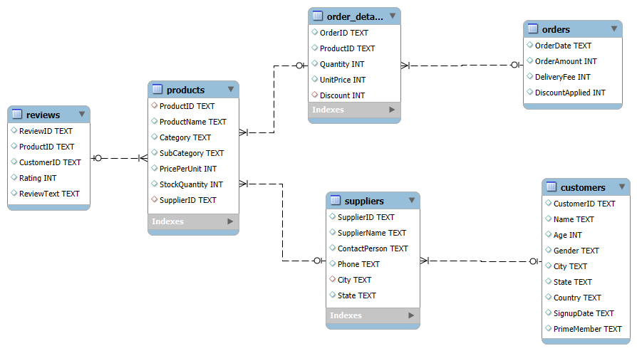
ER DIAGRAM

Slide 5
BASIC QUERIES
Queries are Instruction written in SQL that is used to interact with and retrieve data from a Database.
To retrieve all customers from a specific City and to fetch all products under Fruits category, WHERE clause is used.
WHERE clause helps in Filtering records in a SQL statement. It used to extract only Data that fulfills specific Conditions.

Slide 6
DATA DEFINITION LANGUAGE - DDL
Data Definition Language (DDL) statements are used to manipulate MySQL database schema objects.
DDL Commands: Create, Alter, Rename, Drop, Truncate.
Here, CREATE command is used to Create a New Schema and a New Table.
For Age to be more than 18 and Not Null, CHECK and NOT NULL conditions were applied.
Unique Constrains are added for the Customer Name as varchar(50).

Slide 7
DATA MANIPULATION LANGUAGE - DML
Data Manipulation Language (DML) refers to the set of SQL commands used to manage and manipulate data within database tables.
DML commands : Select, Insert, Update, Delete.
INSERT command is used to insert 3 new rows into the products table.
UPDATE command is used to update stock quantity and WHERE clause is used to filter a specific product ID.
DELETE is used to remove suppliers from a specific City.

Slide 8
SQL CONSTRAINS AND OPERATORS
To ensure that the ratings in the Review table is between 1 and 5, CHECK constrain is used for the Ratings column.
DEFAULT constrain is used to set the Prime Members column to default value ‘No’.
ALTER is used to modify a column in the table.

Slide 9
CLAUSES AND AGGREGATIONS
WHERE Clause is used to filter the Orders placed after ‘01-01-2024’.
AVG is used to calculate the Average Ratings in the Reviews Table.
HAVING clause is applied to Lits the products with the Average Reviews greater than 4.
To Calculate Total Sales SUM is used (Quantity * Unit Price). JOIN is used to combine Product ID from Products and Order Details.
GROUP BY clause helps in arranging identical data into groups.
ORDER BY statement helps in sorting the result in a specific order.(Ascending order, Descending Order)

Slide 10
IDENTIFYING HIGH VALUE CUSTOMERS
To Calculate the Total Spending SUM of (Quantity * Unit Price) is used.
The Total Spending column is conditioned with ORDER BY DESC and RANK () is applied for the Order by function used.
To identify the customer who have spent more than 5000, HAVING clause is used.
The values that are calculate in the query are Columns from different table. To combine those identical values from other tables, JOIN is applied.

Slide 11
COMPLEX AGGREGATIONS AND JOINS
To Calculate the Total Revenue per Order, SUM function is used.
JOIN is applied to combine the Orders and Order Details Table with the identical column as Order ID.
To identify customers who placed orders within a specific time period, COUNT of the Order ID to get the Total Orders and HAVING clauses is implied in the order date.
To find the supplier with most products in Stock, SUM of the stock quantity in the product Table is used to have the Total stock and JOIN is used to combine the Product table and Suppliers Table.
Group by and Order by is applied to arrange the identical column and sort the values in a specific order.

Slide 12
NORMALIZATION
CREATE command is applied to form a new table by separating Product categories and sub-categories.
Foreign keys are created to maintain the relationship between the tables.
Category Id is the primary key in the ProCategory table.
Product Id is the Primary key and Category Id (ProCategory) and SupplierId (Suppliers) are the foreign key that are created.
String Functions such as varchar, Int and decimal are used to create columns like Product name, Category, sub category (Varchar), Category Id, Product Id (Int) and Price per Unit (Decimal).

Slide 13
SUB QUERIES AND NESTED QUERIES
To identify the Top 3 products based on the Sales revenue, SUM is used to find the Total Sales Revenue. Order by is used to sort the values in Descending Order.
JOIN is executed to combine Products table and order details table, then it is Group by Product Id.
LIMIT function is used to restrict the result to Top 3 products.
To find the customers who haven’t placed the order yet, Compare the Customer Id in the orders Table to the Customer Id in the Customers Table.
WHERE condition and NOT EXIST sub query is used to filter and sort the customer Id that are present in both the tables.

Slide 14
REAL WORLD ANALYSIS
Patelberg, North Christopher and Lake Christopher has the Highest Concentration of Prime Members with Prime Percentage being 100.
COUNT (Total Customers), SUM (Prime Members = Yes) and ROUND (Prime Percentage) is applied to calculate the concentration of Prime Members.
Meat, fruits and Snacks are the Most ordered Product category with Total ordered as 11108, 9921and 9651 respectively.
SUM (Quantity) to get the Total Orders, JOIN (Products, Order Details), and LIMIT 3 (Top 3 Category).

Slide 15
FINDINGS
The Top 3 Most ordered Categories are Meat, Fruits, Snacks and the Top 3 products based on Sales Revenue are Capital Snacks, Society vegetable, Fish Dair.
The Total Sales of Capital Snacks, Society Vegetables and Fish Dair are 1,10,875 / 1,03,430 / 1,00,727 respectively.
The Most concentrated Prime Members are present in the following Cities: Patelberg, North Christopher and Lake Christopher.
The High Value Customers with Highest Total Spending are from the states such as Delaware, Idaho, New York and California.

Slide 16
CONCLUSION
Amazon fresh needs to focus on customers who haven’t ordered yet by Digital marketing with engaging content and offers.
Based on the customer Review, Amazon Fresh can analyze the customer satisfaction of a product.
Enhance Customer satisfaction by Evaluating Products with Low ratings for Quality improvement and those with High Reviews for Optimized Inventory Management.
Build a strong relationship with suppliers from all regions and Strategize inventory by forecasting the Product Demand through Purchase Behavior.
States like Delaware, Idaho, New York and California has the High Value customers, so give importance in improvisation of the marketing strategy and Optimization of Product Quality.

Slide 17
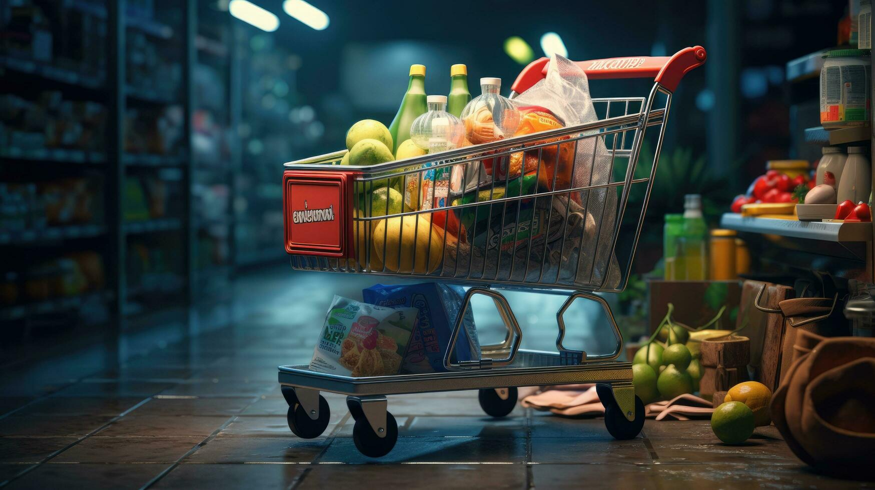
THANK YOU

